Slide 1

Keeping Your Renters Happy:
An Analysis of Airbnb Ratings & Reviews
Eric Ngo & Kaylee Trinh
BAIS 6100: Text Analytics

Slide 2
Questions of interest
What influences the ratings & reviews of customers on Airbnb?
What do they talk about when reviewing an Airbnb property?
How do these patterns differ across cities?

Slide 3
Data Description
2 listing details & reviews datasets: Bangkok & San Francisco
~250,000 and ~350,000 reviews in each dataset
20 variables included, mainly focus on: host info, host info sentiment, host experience, super host, neighborhood description sentiment, price, number of reviews

Slide 4
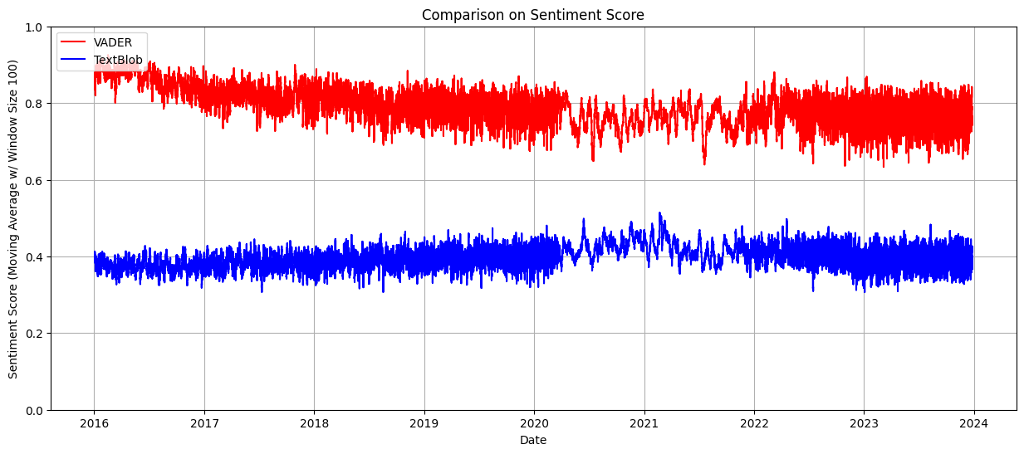
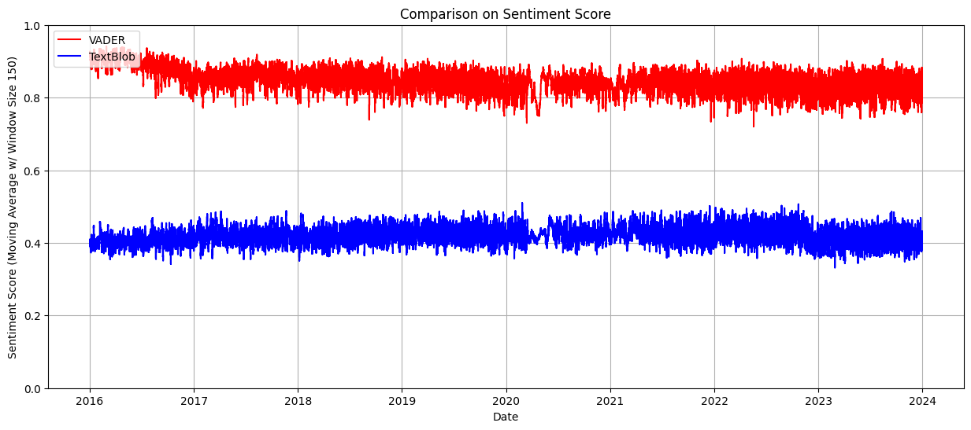
Sentiment Trends
Bangkok
San Francisco
Relatively similar trends across 2 cities
SF generally higher (always above 0.8), while BK’s overall sentiment gradually decrease (to 0.7)
During 2 COVID years (2020 – 2022), the trend lines are thinner for BK, but less so for SF

Slide 5
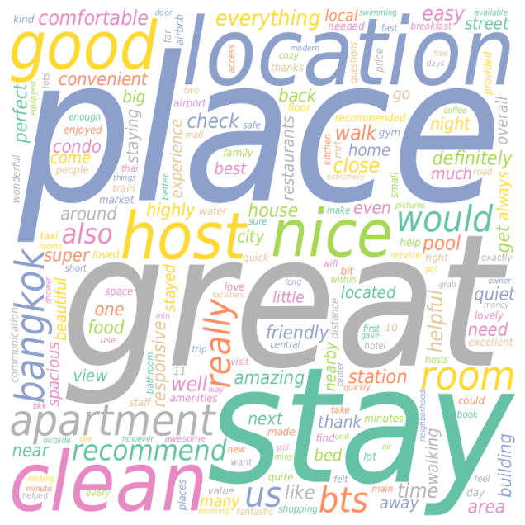
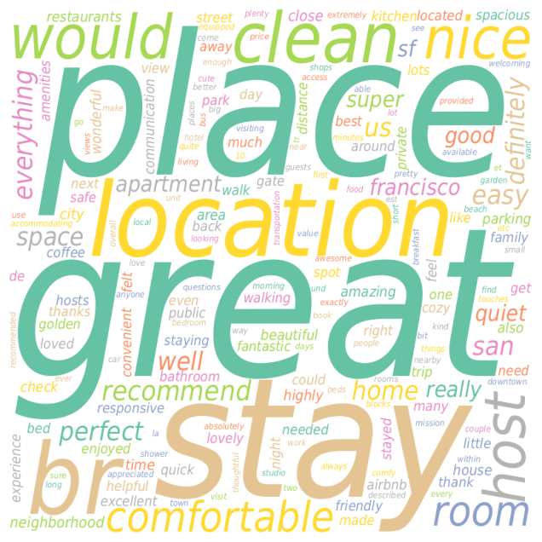
Common Topics: Word Clouds
Similar trends for both Bangkok & SF.
Unsurprising: Guests everywhere would prefer places that are clean, nice hosts, and at good locations.
Bangkok
San Francisco

Slide 6
Common topics in reviews

Slide 7
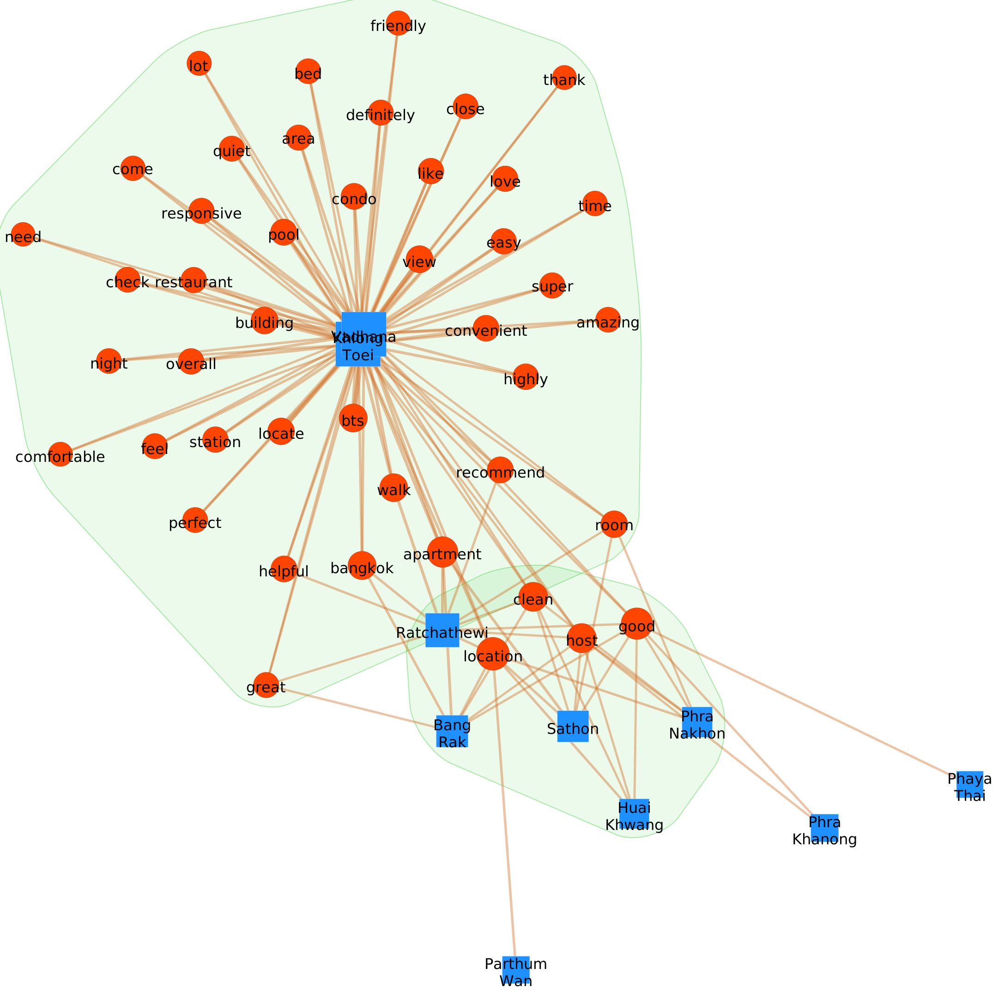
Topics by Neighborhood: Text Network
Bangkok
3 Main Clusters.
Central Neighborhood: Vadhana & Khlong Toei
  Airbnbs have good locations, many amenities, & great hosts
    Pools, view, comfortable
    Restaurants, stations
    Responsive, helpful, friendly
  Most loved
    Love, perfect, amazing, super
Good Neighborhoods: 4 Districts
  Location, clean, good host
OK Neighborhoods: 3 Districts (Isolates)

Slide 8
Topics by Neighborhood: Text Network
Bangkok
3 Main Clusters.
Central Neighborhood: Vadhana & Khlong Toei
  Airbnbs have good locations, many amenities, & great hosts
    Pools, view, comfortable
    Restaurants, stations
    Responsive, helpful, friendly
  Most loved
    Love, perfect, amazing, super
Good Neighborhoods: 4 Districts
  Location, clean, good host
OK Neighborhoods: 3 Districts (Isolates)

Slide 9
Topics by Neighborhood: Text Network
Bangkok
3 Main Clusters.
Central Neighborhood: Vadhana & Khlong Toei
  Airbnbs have good locations, many amenities, & great hosts
    Pools, view, comfortable
    Restaurants, stations
    Responsive, helpful, friendly
  Most loved
    Love, perfect, amazing, super
Good Neighborhoods: 4 Districts
  Location, clean, good host
OK Neighborhoods: 3 Districts (Isolates)

Slide 10
Topics by Neighborhood: Text Network
Bangkok
3 Main Clusters.
Central Neighborhood: Vadhana & Khlong Toei
  Airbnbs have good locations, many amenities, & great hosts
    Pools, view, comfortable
    Restaurants, stations
    Responsive, helpful, friendly
  Most loved
    Love, perfect, amazing, super
Good Neighborhoods: 4 Districts
  Location, clean, good host
OK Neighborhoods: 3 Districts (Isolates)

Slide 11
Topics by Neighborhood: Text Network
Bangkok
3 Main Clusters.
Central Neighborhood: Vadhana & Khlong Toei
  Airbnbs have good locations, many amenities, & great hosts
    Pools, view, comfortable
    Restaurants, stations
    Responsive, helpful, friendly
  Most loved
    Love, perfect, amazing, super
Good Neighborhoods: 4 Districts
  Location, clean, good host
  1 District Overlapping with Cluster 1
OK Neighborhoods: 3 Districts (Isolates)

Slide 12

Topics by Neighborhood: Text Network
Bangkok
3 Main Clusters.
Central Neighborhood: Vadhana & Khlong Toei
  Airbnbs have good locations, many amenities, & great hosts
    Pools, view, comfortable
    Restaurants, stations
    Responsive, helpful, friendly
  Most loved
    Love, perfect, amazing, super
Good Neighborhoods: 4 Districts
  Location, clean, good host
  1 District Overlapping with Cluster 1
OK Neighborhoods: 3 Districts (Isolates)
???

Slide 13
Topics by Neighborhood: Text Network
Bangkok
3 Main Clusters.
Central Neighborhood: Vadhana & Khlong Toei
  Airbnbs have good locations, many amenities, & great hosts
    Pools, view, comfortable
    Restaurants, stations
    Responsive, helpful, friendly
  Most loved
    Love, perfect, amazing, super
Good Neighborhoods: 4 Districts
  Location, clean, good host
OK Neighborhoods: 3 Districts (Isolates)

Slide 14
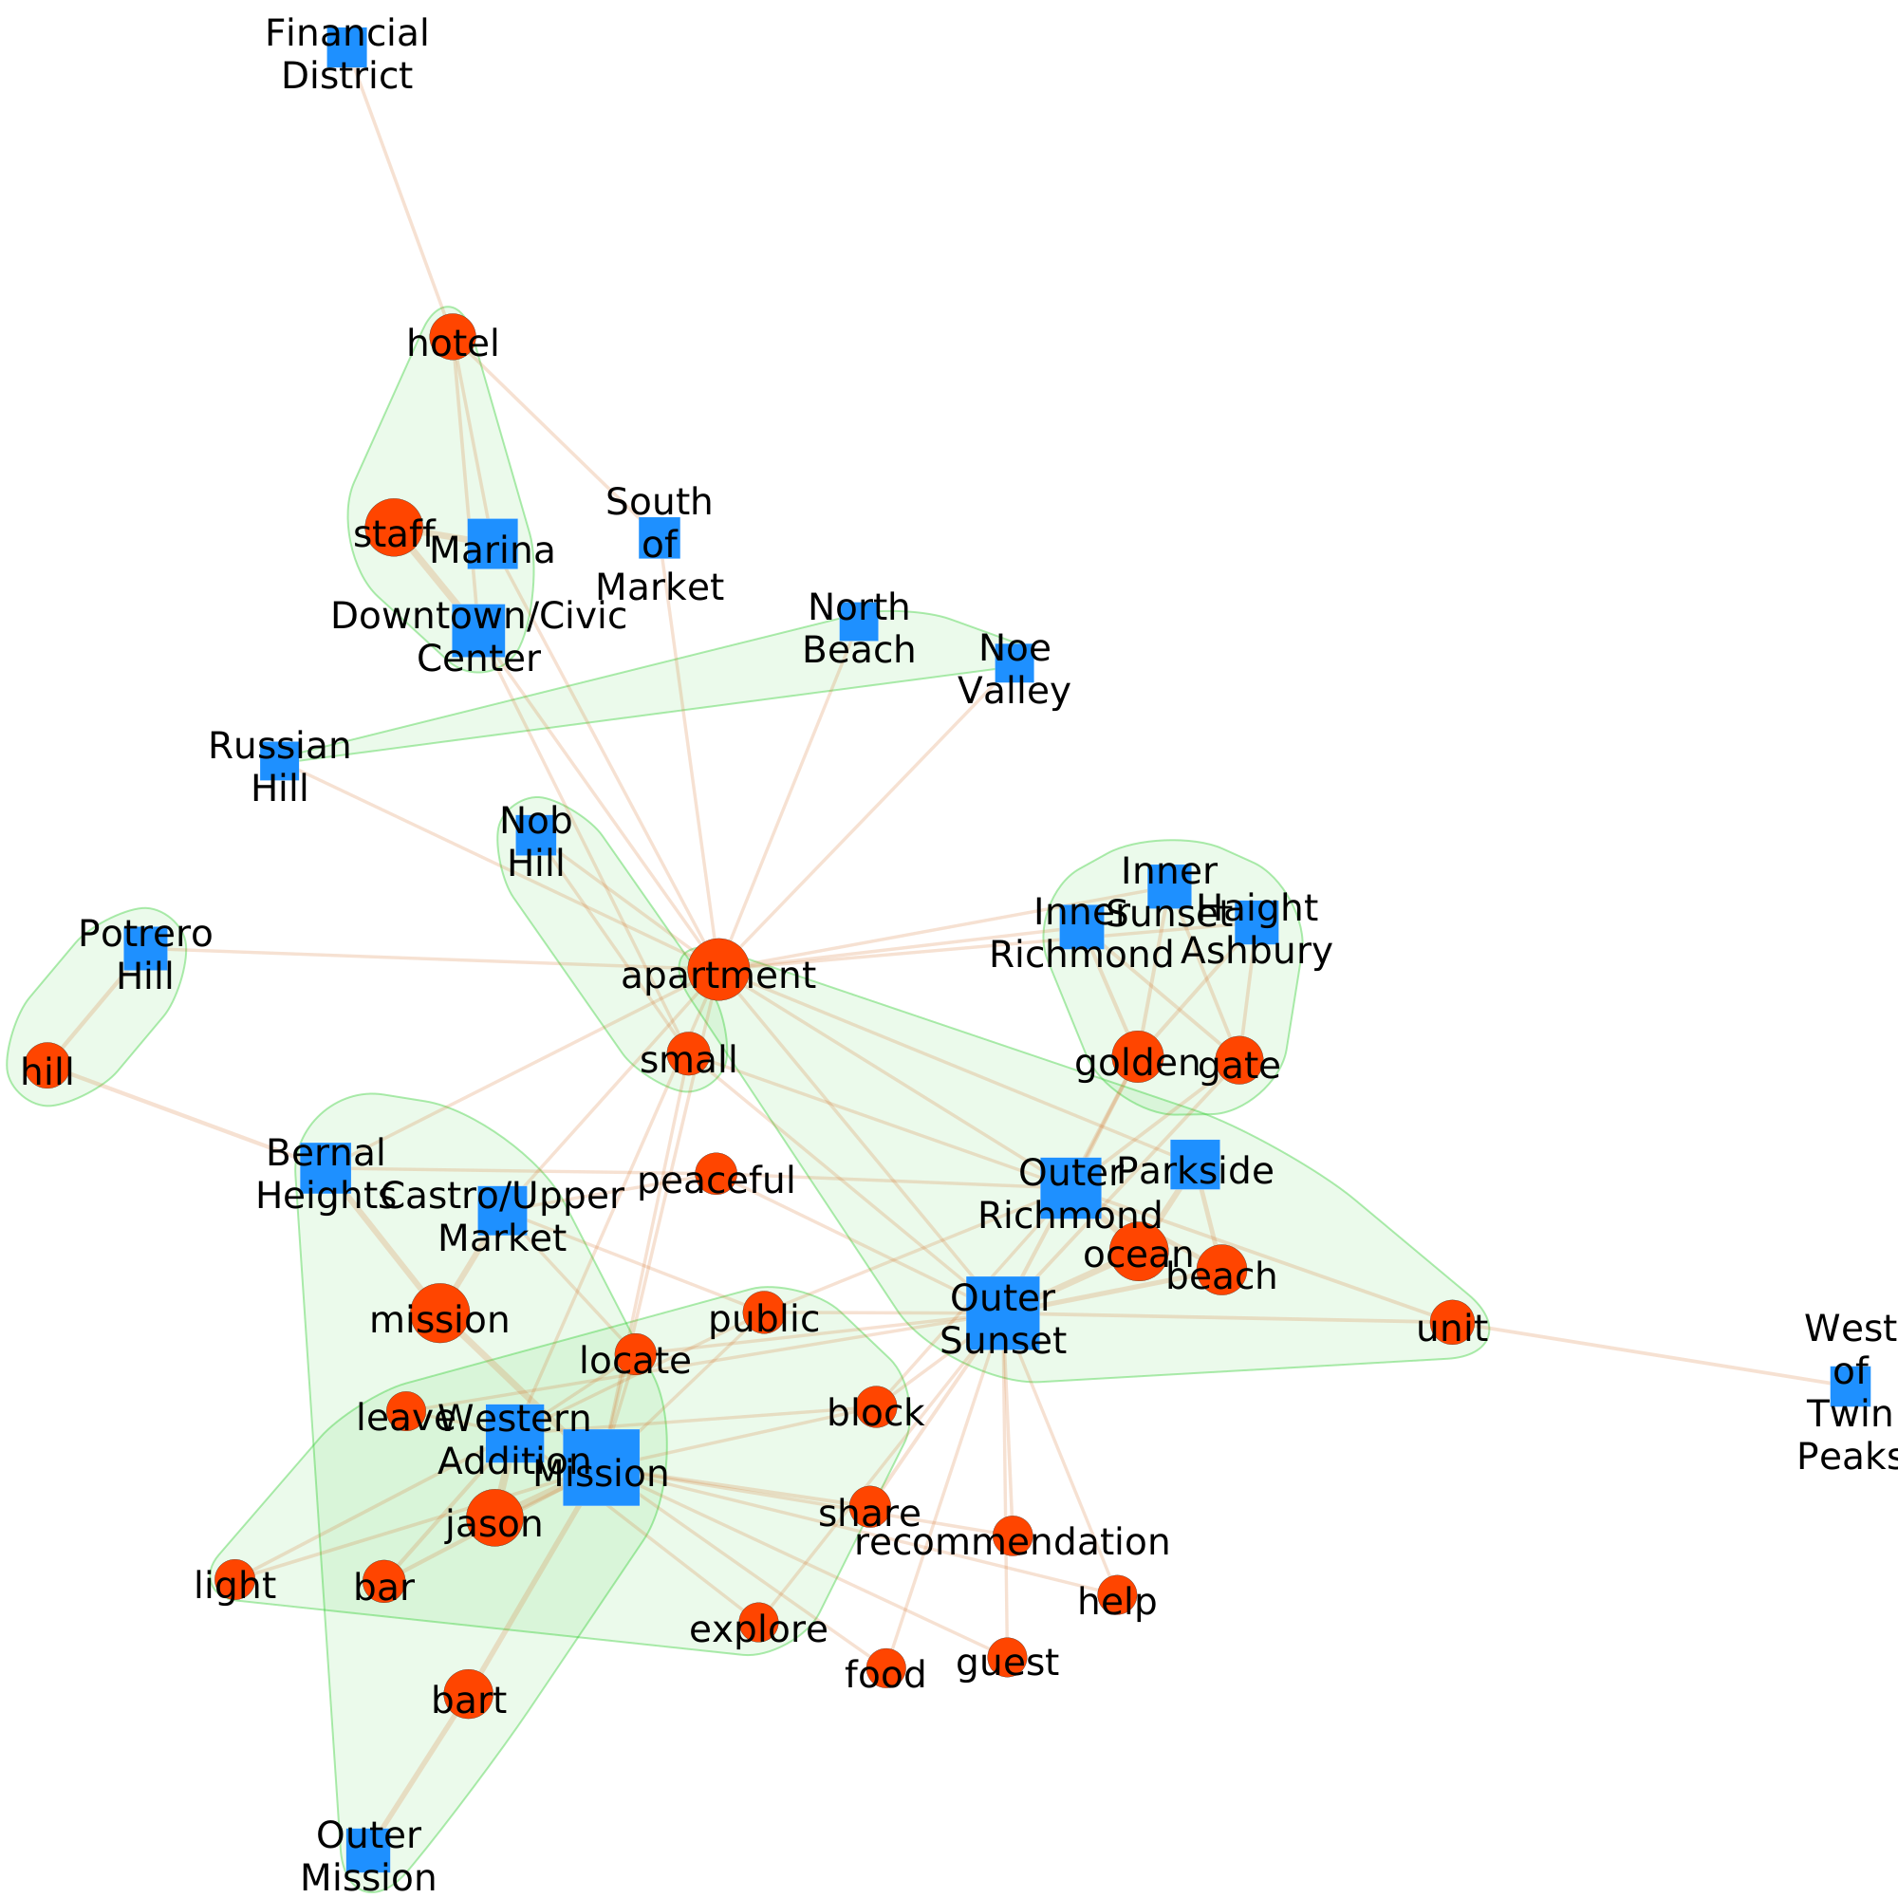
Topics by Neighborhood: Text Network
San Francisco
Downtown & Financial District Neighborhood
  Interactions with hotel staff
Nature lovers: Outer Richmond, Parkside, Outer Sunset
  Golden gate bridge
  Ocean/ beach
Close to Western Addition & Mission
  Good location, public transportation, bar
Shared sentiment: good for guests to explore the city

Slide 15
Topics by Neighborhood: Text Network
San Francisco
Downtown & Financial District Neighborhood
  Interactions with hotel staff
Nature lovers: Outer Richmond, Parkside, Outer Sunset
  Golden gate bridge
  Ocean/ beach
Close to Western Addition & Mission: Fun night life
  Good location, public transportation, bar
Shared sentiment: good for guests to explore the city

Slide 16
Topics by Neighborhood: Text Network
San Francisco
Downtown & Financial District Neighborhood
  Interactions with hotel staff
Nature lovers: Outer Richmond, Parkside, Outer Sunset
  Golden gate bridge
  Ocean/ beach
Close to Western Addition & Mission: Fun night life
  Good location, public transportation, bar
Shared sentiment: good for guests to explore the city

Slide 17
Topics by Neighborhood: Text Network
San Francisco
Downtown & Financial District Neighborhood
  Interactions with hotel staff
Nature lovers: Outer Richmond, Parkside, Outer Sunset
  Golden gate bridge
  Ocean/ beach
Night/bar districts: Close to Western Addition & Mission
  Good location, public transportation, light, bar
Shared sentiment: good for guests to explore the city

Slide 18
Topics by Neighborhood: Text Network
San Francisco
Downtown & Financial District Neighborhood
  Interactions with hotel staff
Nature lovers: Outer Richmond, Parkside, Outer Sunset
  Golden gate bridge
  Ocean/ beach
Night/bar districts: Close to Western Addition & Mission
  Good location, public transportation, bar
Shared sentiment: good for guests to explore the city

Slide 19
Common topics in negative reviews
5000 comments w/ lowest Vader score

Slide 20
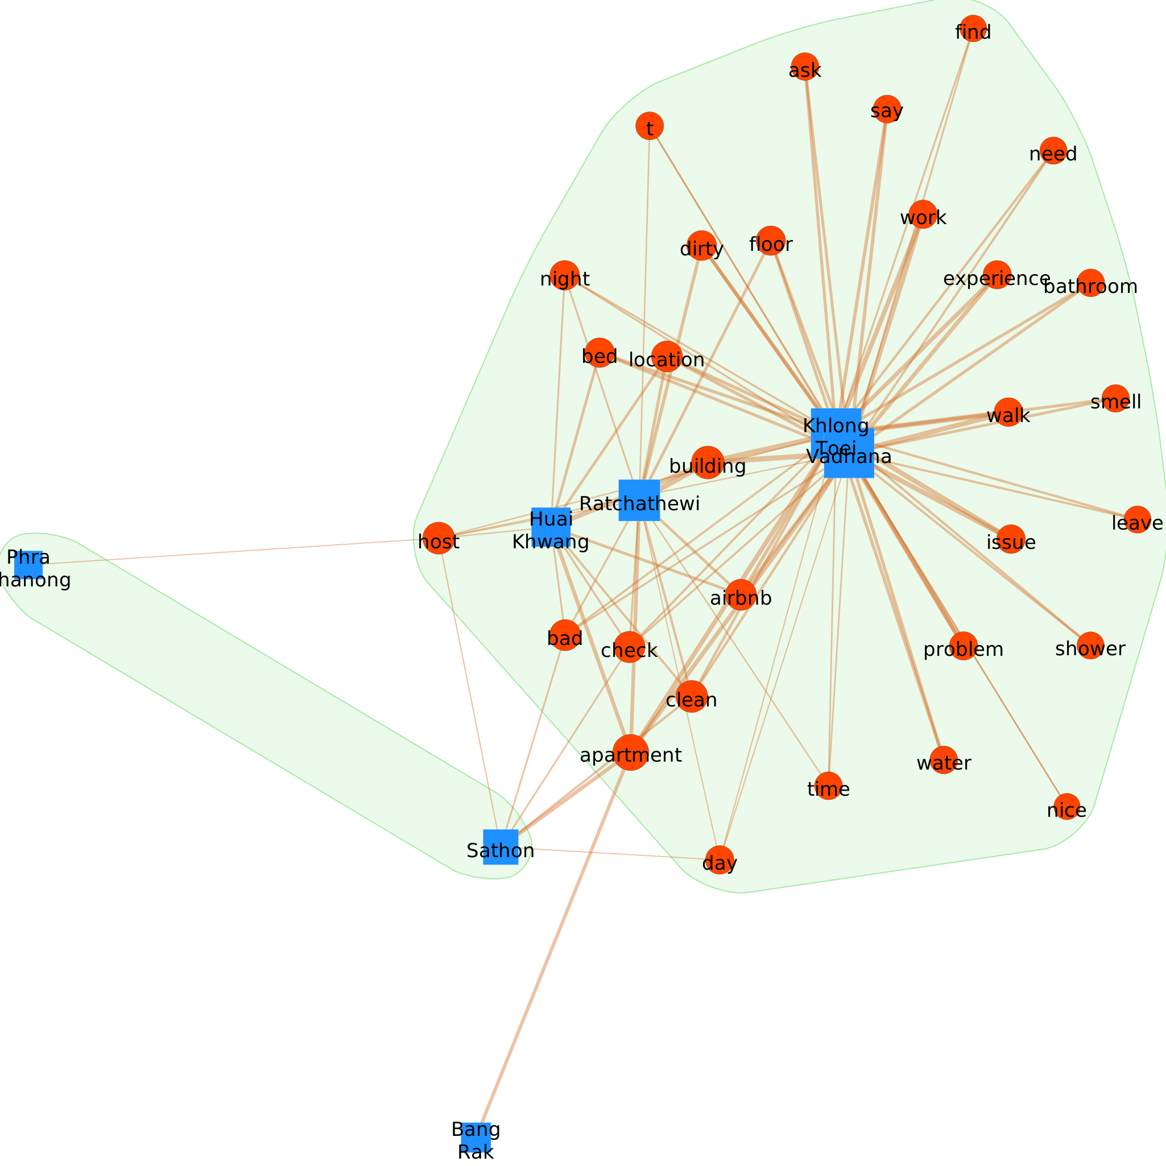
Most Negative Topics: Text Network
Bangkok
The 2 central districts also receive most complaints.
  Unclean, dirty
  Smell
Ratchathewi also have complaints about cleanliness
Phra Khanong (an OK neighborhood) sometimes gets negative reviews about hosts.

Slide 21
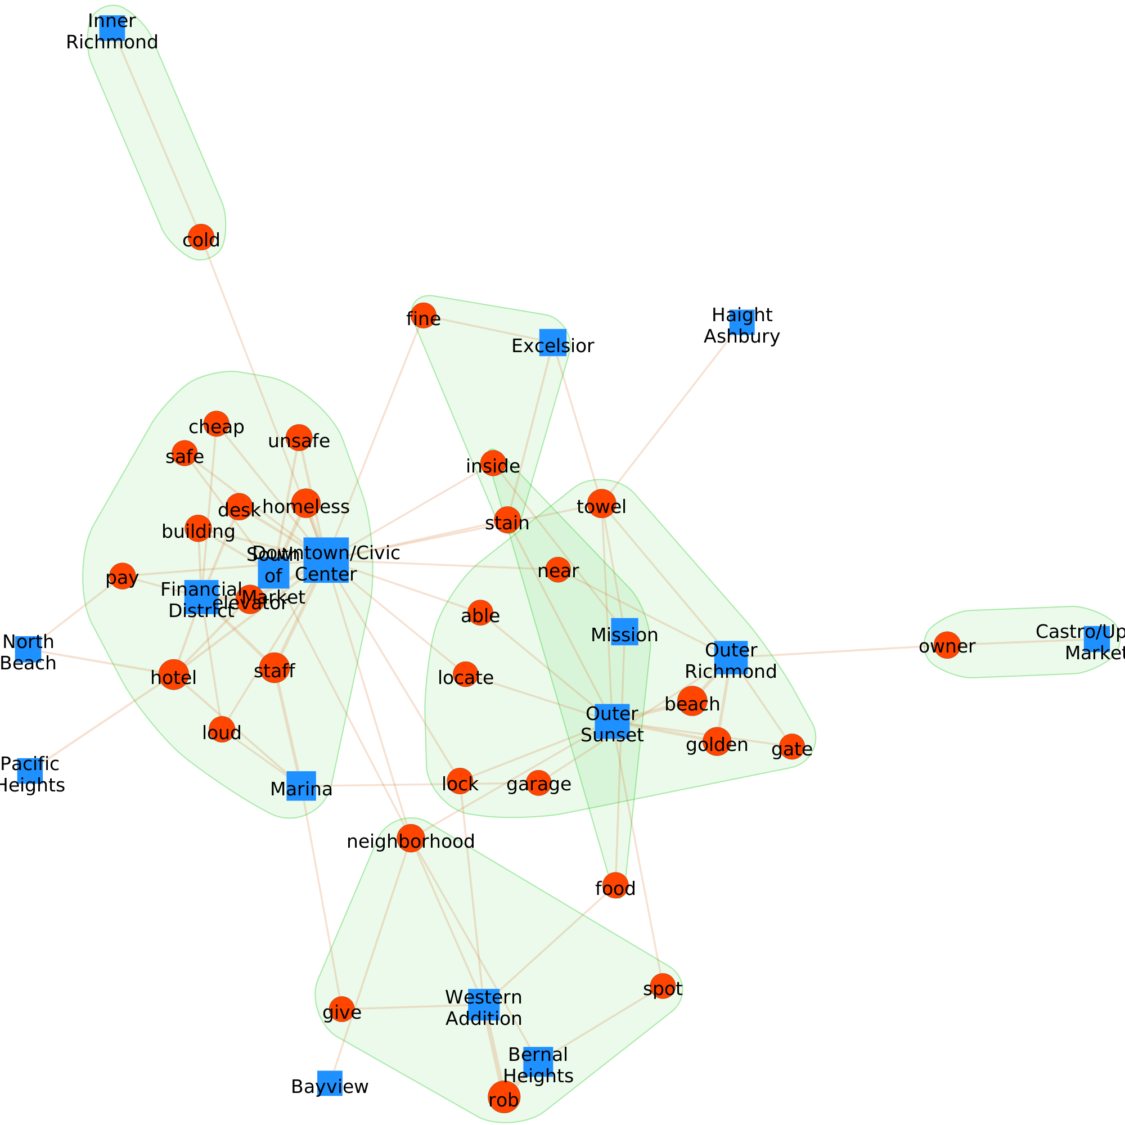
Most Negative Topics: Text Network
San Francisco
Mainly from the Downtown/ Civic Center area
  loud
  homeless, unsafe
Some complaints about stain, towel in other areas

Slide 22
Regression Analysis

Slide 23
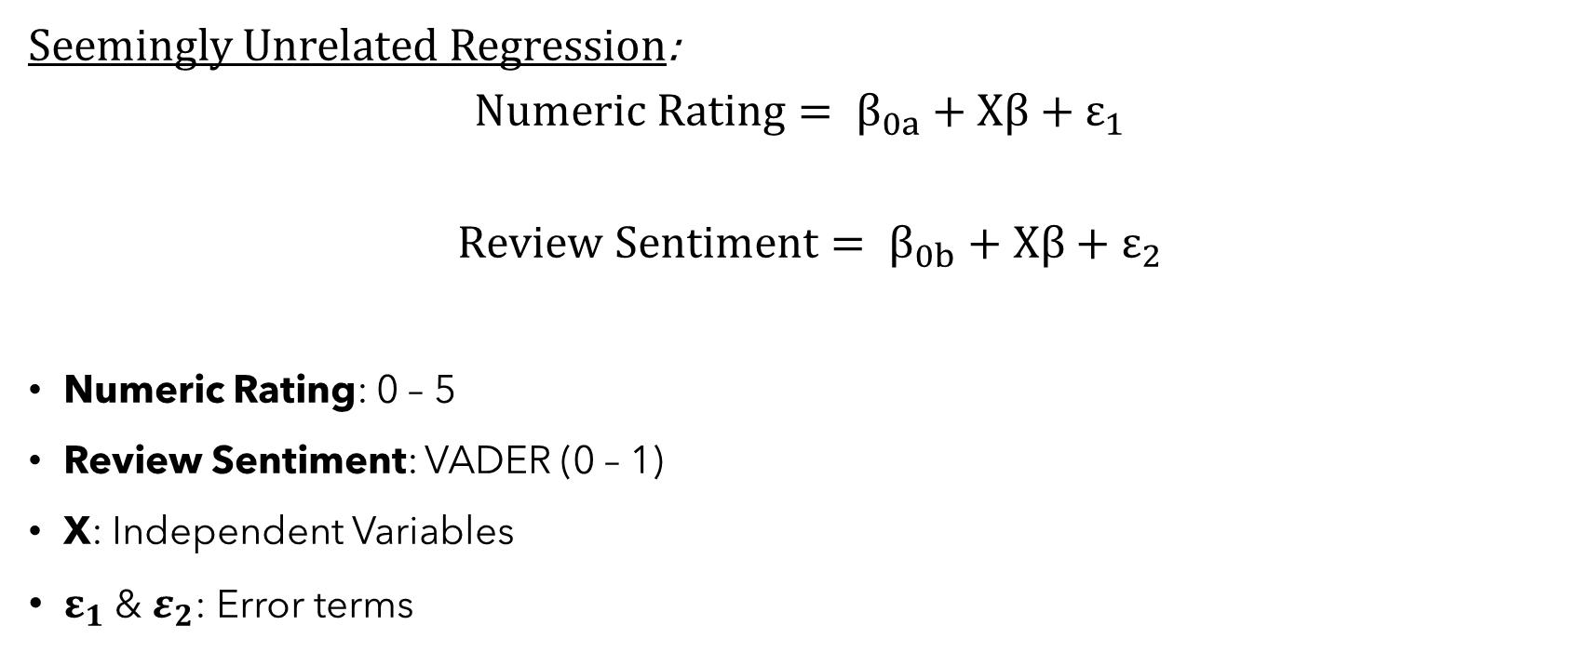
Regression Analysis: Simultaneous Equations Models
Seemingly Unrelated Regression:
$$Numeric Rating= β_{0a}+Xβ+ε_{1}$$
$$Review Sentiment= β_{0b}+Xβ+ε_{2}$$
Numeric Rating: 0 – 5
Review Sentiment: VADER (0 – 1)
X: Independent Variables
$ε_{1}$ & $ε_{2}$: Error terms

Slide 24
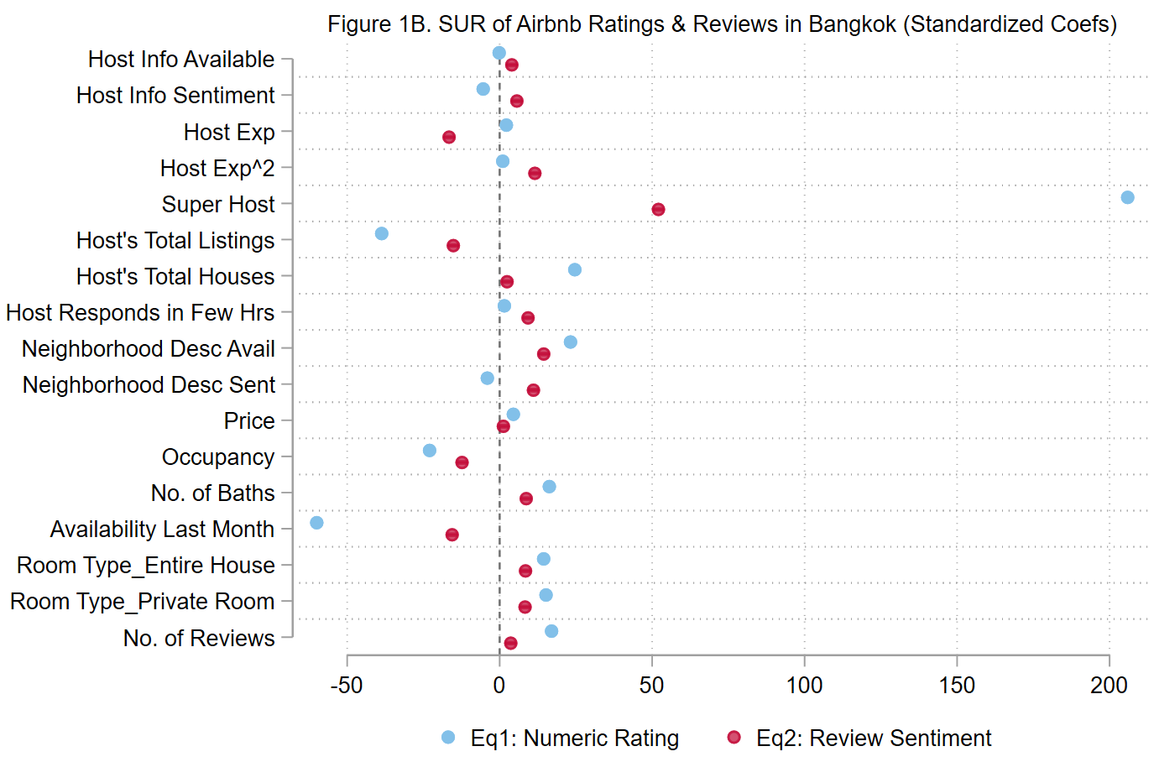
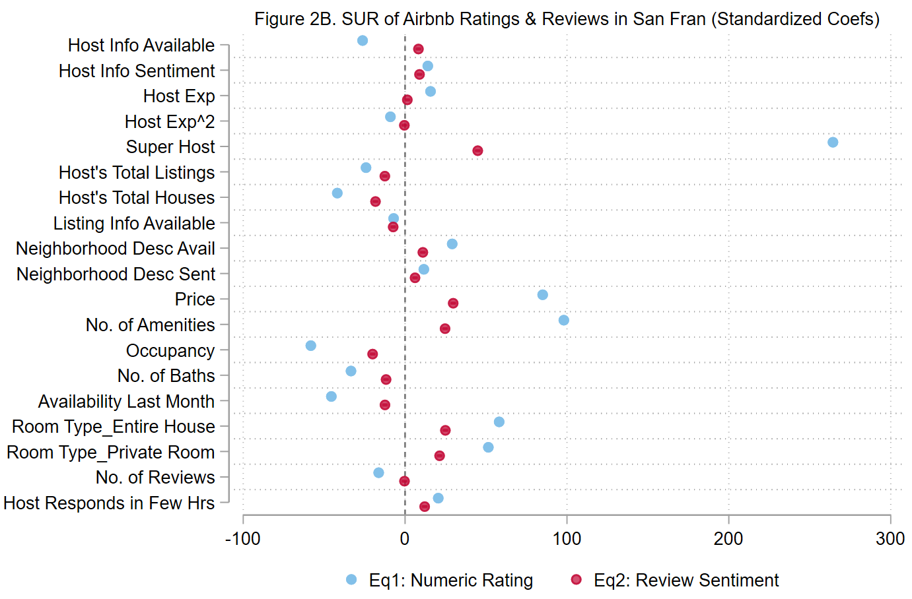
Regression Analysis: Simultaneous Equations
Bangkok
San Francisco

Slide 25
Regression Analysis: Simultaneous Equations
Bangkok
San Francisco

Slide 26
Regression Analysis: Simultaneous Equations
Bangkok
San Francisco

Slide 27
Regression Analysis: Simultaneous Equations
Bangkok
San Francisco

Slide 28
Regression Analysis: Simultaneous Equations
Bangkok
San Francisco

Slide 29
Regression Analysis: Simultaneous Equations
Bangkok
San Francisco

Slide 30
Regression Analysis: Simultaneous Equations
Bangkok
San Francisco

Slide 31
Conclusion
Reviews are often positive in both places
Guests mention similar aspects of an Airbnb property in their reviews
  Whether the place is clean, have good hosts, good locations, etc.
How you describe & advertise about yourself & property matter
  More positive bios & descriptions → impact customer feedback.
Being a good host is important
  The most powerful predictor of the review score & sentiment the most
Some inherent differences between cities
  Opposite sides of the Earth, different rules, cultures, economies.
  BK neighborhoods are mostly distinguished by their amenities & features.
  SF neighborhoods seem have more distinct characteristics.
    Beach-nature districts, night/bar districts, Hotel/downtown

